Slide 1

ARM Memory Interface
Arm Bus Signal, Single Memory Interface, Control signal and Different accessing ways

Slide 2
ARM Bus Signals
Memory bus interface signals include the following:
A 32 bit address bus
A 32 bit bidirectional bus
Signals specifying what kind of memory requirement (mreq, seq)
Signals specifying direction and size of memory
Bus Timing and control signals (abe, ale, ape, dbe, lock, bl[3:0]).

Slide 3
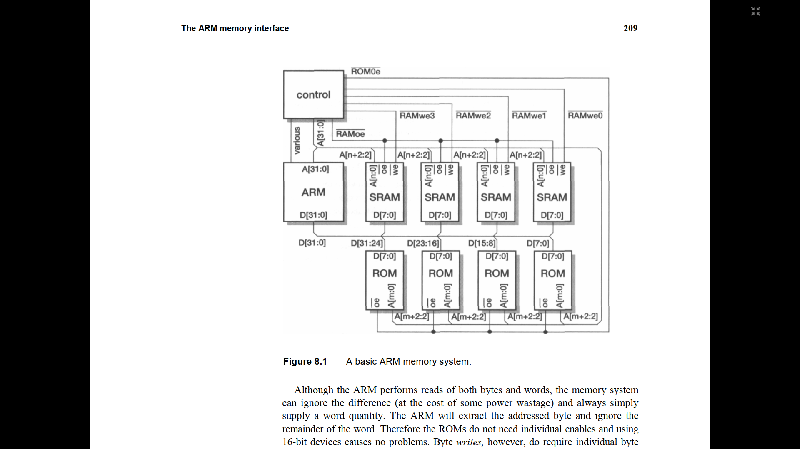
A basic ARM Memory System(1/2)

Slide 4
A basic ARM Memory System(2/2)
This figure illustrates the connection of 8-bit memory parts, which are a standard configuration for SRAMs and ROMs.
The output enable signals (RAMoe and ROMoe) and the write enables (RAMwe) is seen in figure
ROM can have a word access unlike RAM where separate enable for every 8 bit needed
For ROM word access, [31:2] bits required, [1:0] can be used as control signals and for half word access [0] bit can be used for control signal.

Slide 5
Control Logic
It performs mainly three functions:
It decides when to activate the RAM and when to activate the ROM.
It controls the byte write enables during a write operation
It ensures that the data is ready before the processor continues.

Slide 6
Stretching Access cycles
The ARM7TDMI processor does not contain any dynamic logic that relies on regular clocking to maintain the internal state. Therefore, there is no limit upon the maximum period for which MCLK can be stretched, or WAIT state held LOW. There are two methods available to stretch access times as described in:
Modulating MCLK
Use of WAIT state to control bus cycles.

Slide 7
Modulating MCLK
All memory timing is defined by MCLK, and long access times can be accommodated by stretching this clock. It is usual to stretch the LOW period of MCLK, because this enables the memory manager to abort the operation if the access is eventually unsuccessful.
MCLK can be stretched before being applied to the processor, or the WAIT state input can be used together with a free-running MCLK. Taking WAIT state LOW has the same effect as stretching the LOW period of MCLK.

Slide 8
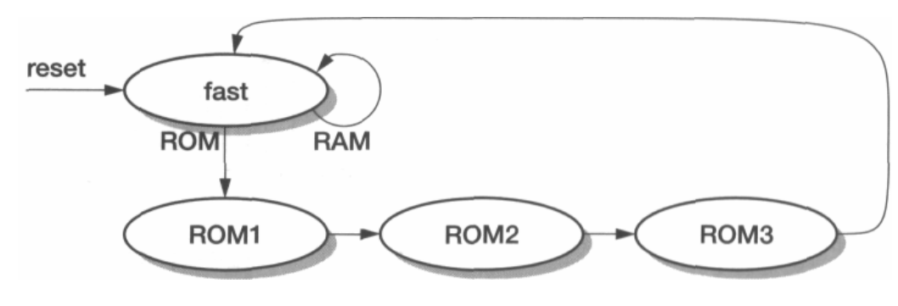
Wait States
ROM Wait control state transition diagram

Slide 9
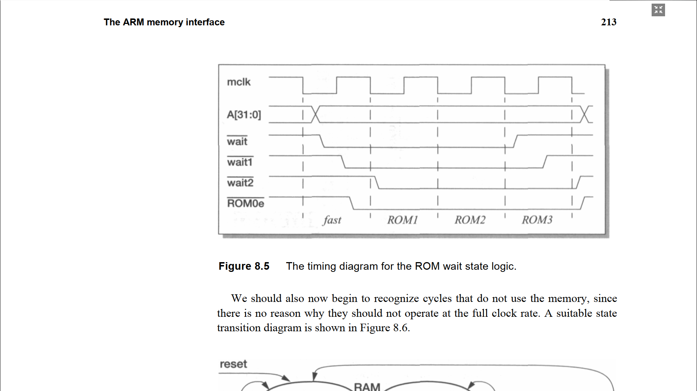
The timing diagram for the ROM wait state logic

Slide 10
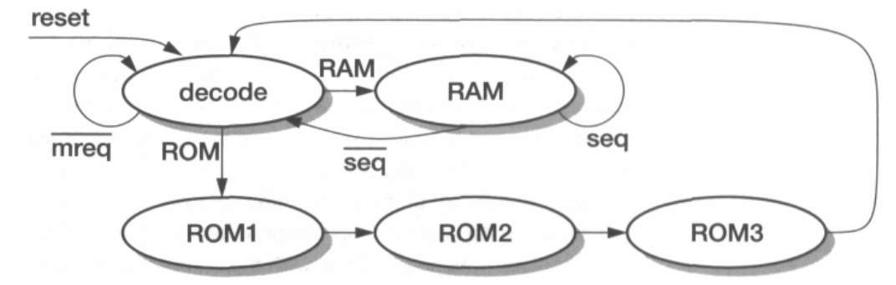
Memory Access required or not?
State transition diagram with a wait state for address decoding:

Slide 11
Dynamic RAM (DRAM)
Cheapest memory technology
Stores information as electrical charge on capacitor
Memory control logic refreshes the DRAM, so that information can be stored safely somewhere else.

Slide 12
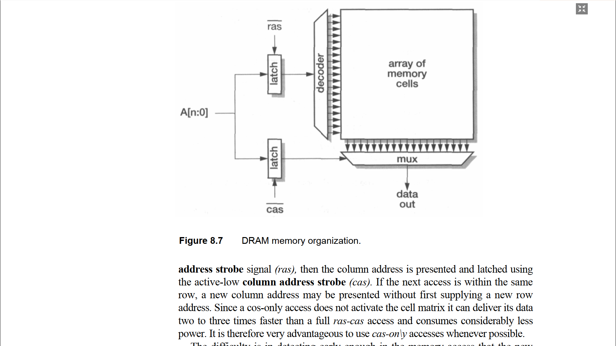
DRAM Memory organization(1/2)

Slide 13
DRAM Memory organization(2/2)
The row address is presented and latched using the active-low row address strobe signal (ras)
The column address is presented and latched using the active-low column address strobe (cas)
Very advantageous to use cas-only accesses whenever possible

Slide 14
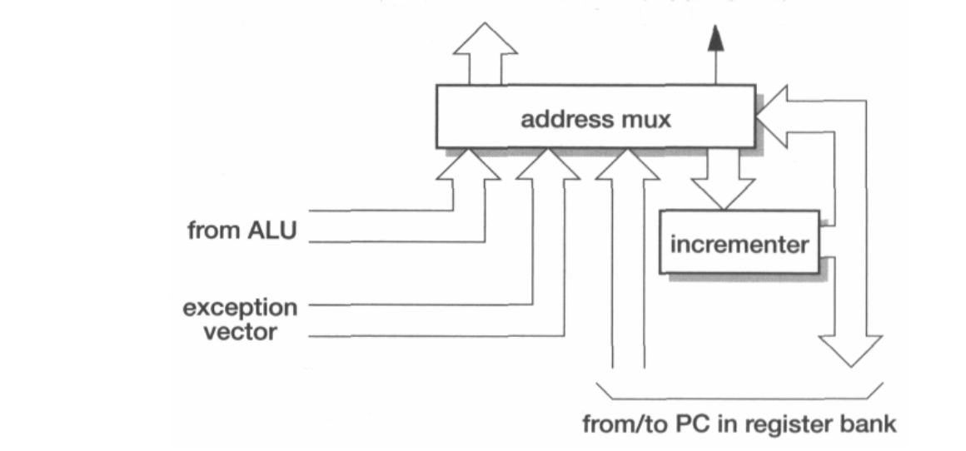
ARM Address Incrementor

Slide 15
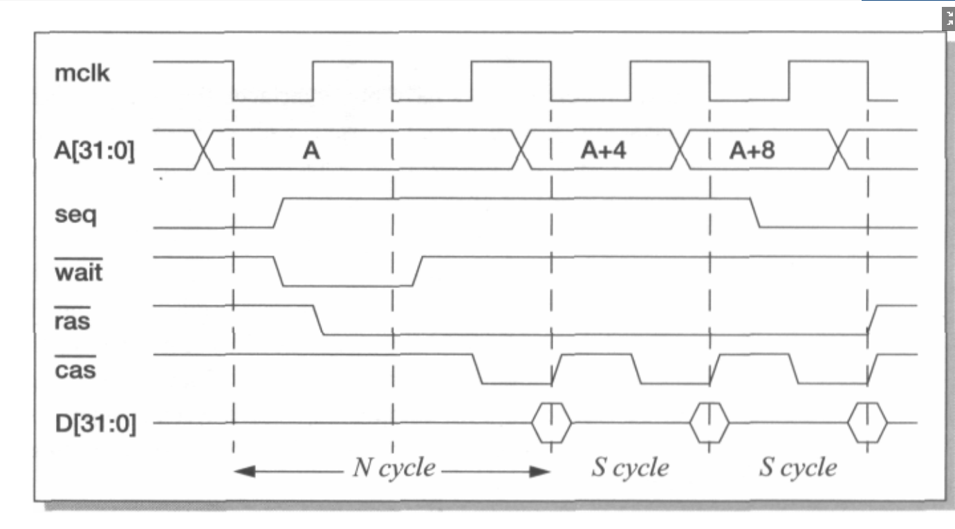
DRAM Timing Illustration

Slide 16
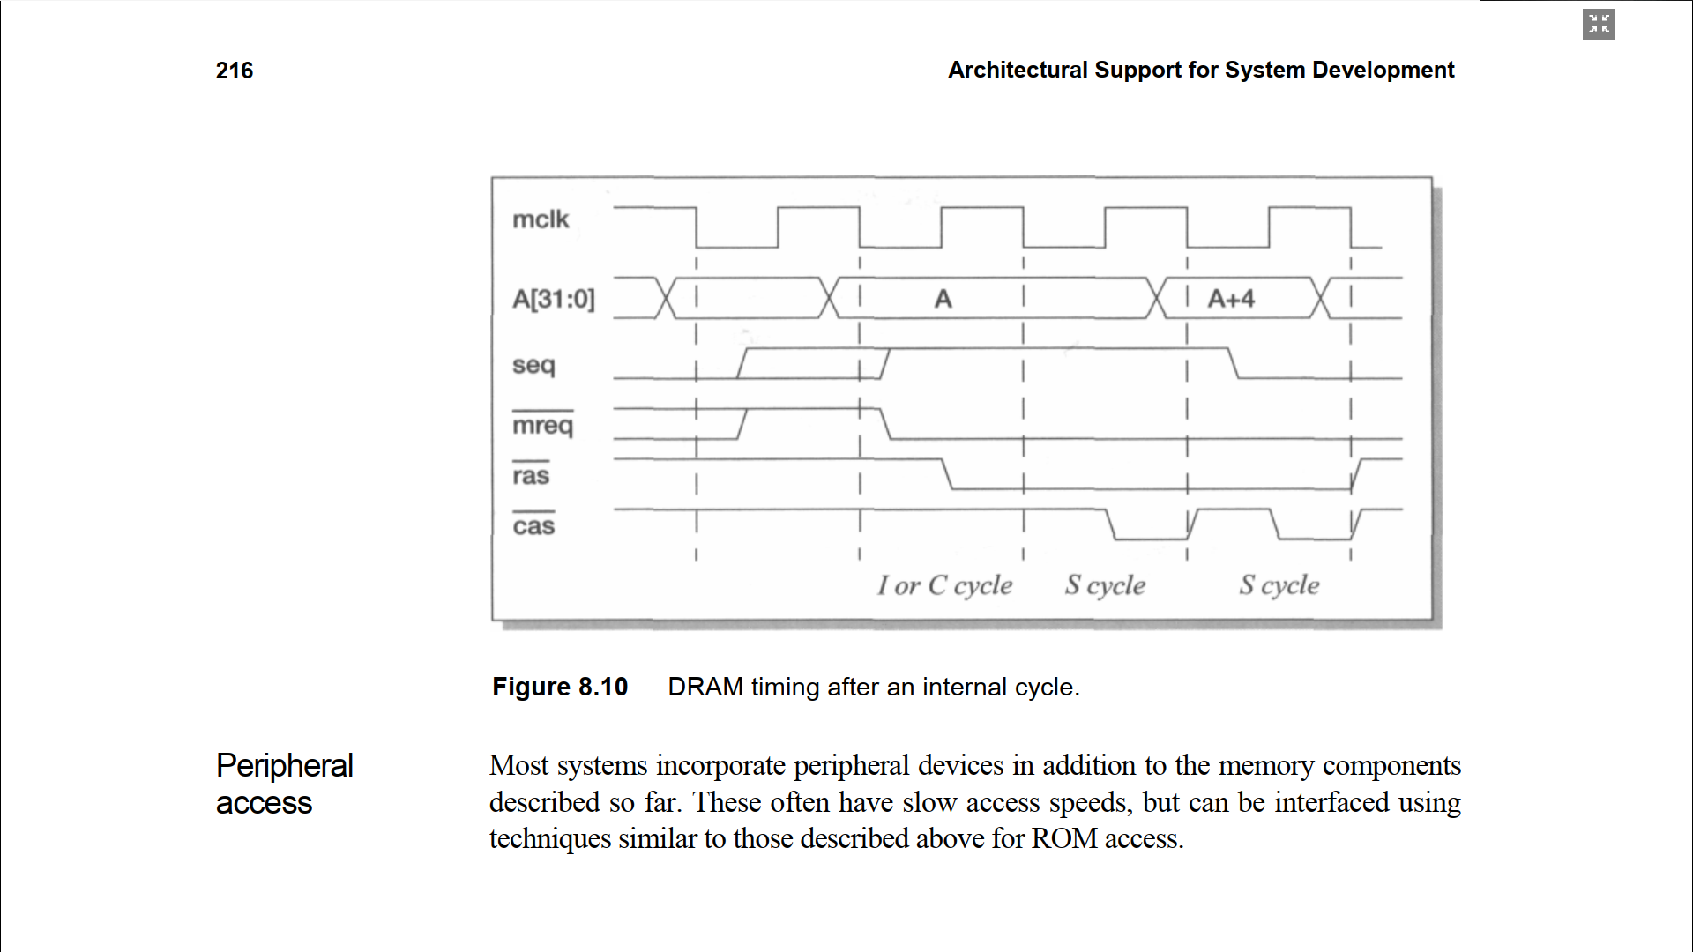
DRAM timing after an internal cycle

Slide 17
Thank You…!

